Slide 1
Setting up Python on Windows x64
Includes installing:
Python 3.6
Notepad Plus Plus
Jupyter Notebook
PyInstaller
Hamilton Python Users Group
Ian Stewart
12-March-2018.
Slide Show is intended as a reference document.
https://github.com/HamPUG/meetings/tree/master/2018/2018-03-12

Slide 2
Objective: Python development environment for Windows
Desktop with Python installed.
Jupyter Notebook
Develop / Test Code snippets.
Notebook++
Main Program source code
File Manager or CMD console
to Run Program
PyInstaller - Distribution

Slide 3
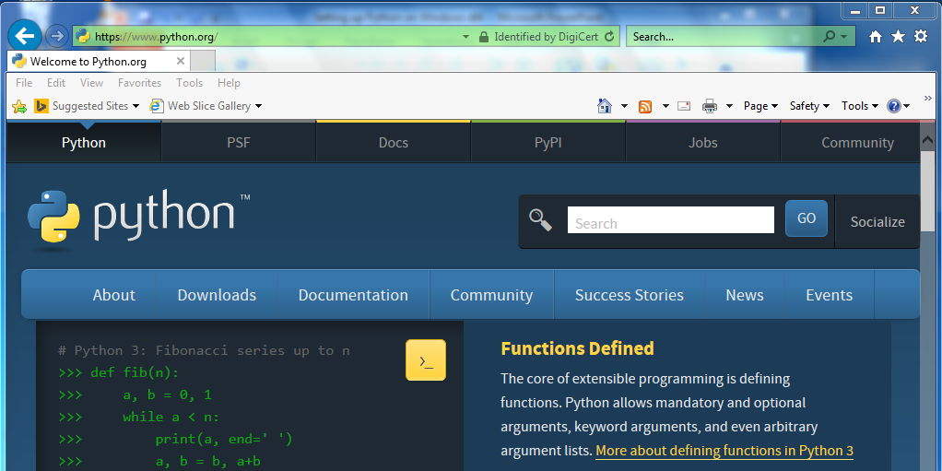
Installing Python3
Go to www.python.org
Click : Downloads

Slide 4
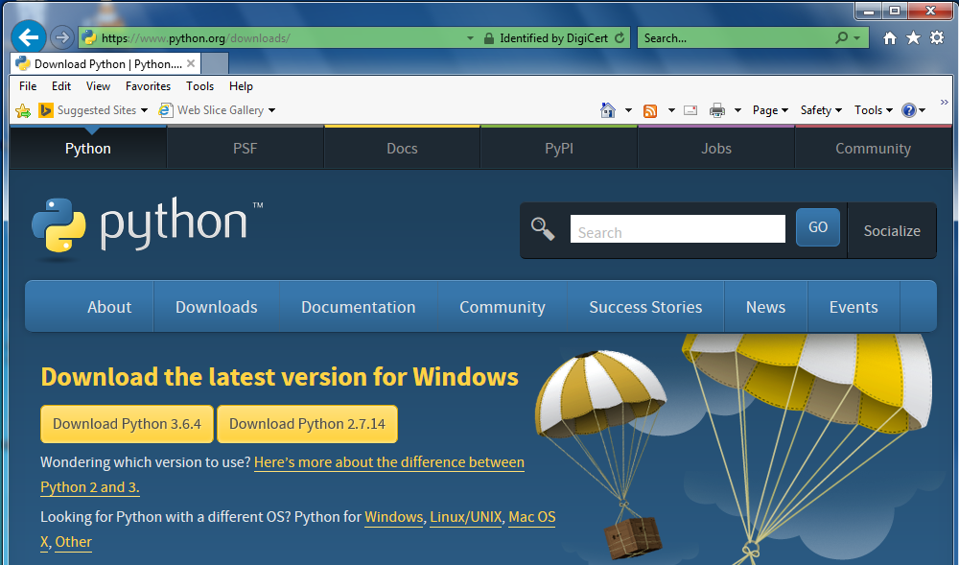
Installing Python3
Click: Python for Windows

Slide 5
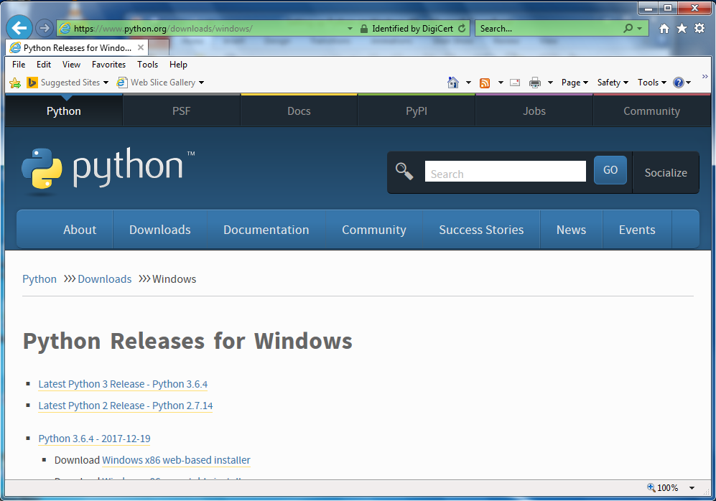
Installing Python3
Scroll down on this window…

Slide 6
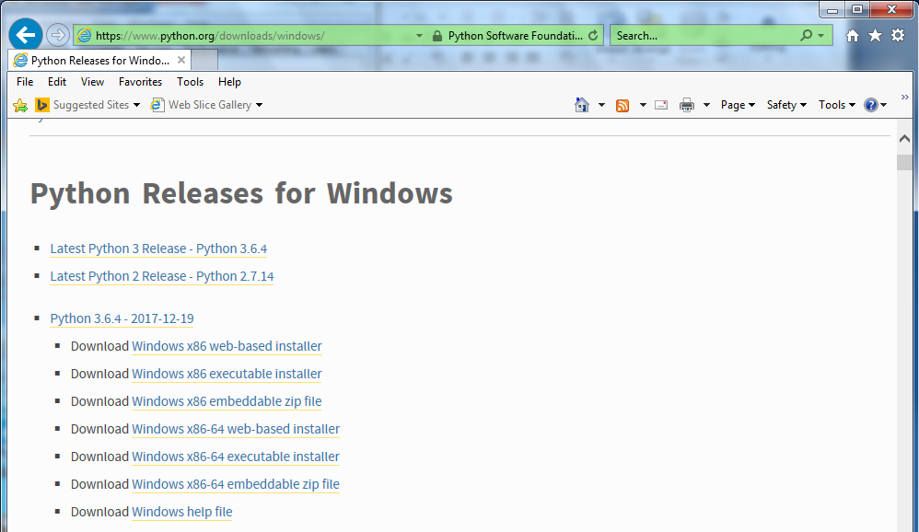
Installing Python3
Click: Download Windows x86-64 executable installer

Slide 7
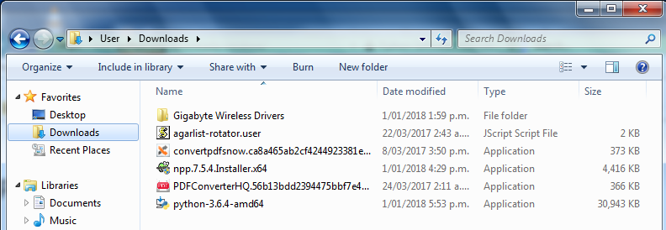
Installing Python3
Click: Save
Go to downloads folder
Double Click: python-3.6.4-amd64

Slide 8
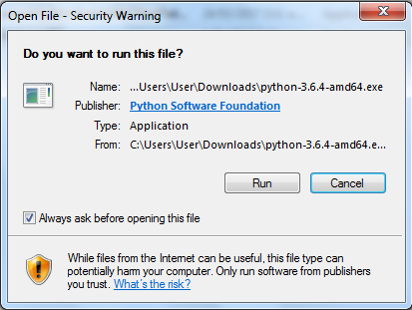
Installing Python3
Click: Run

Slide 9
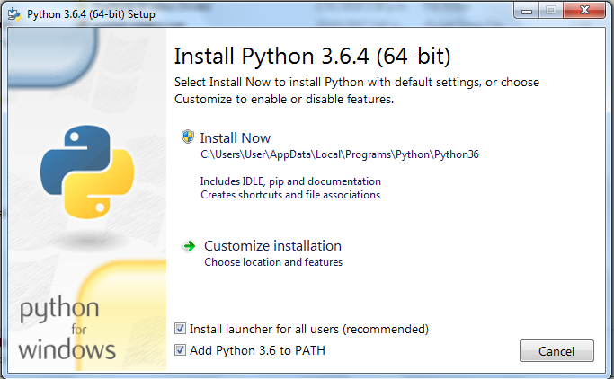
Installing Python3
Checkbox: Add Python 3.6 to PATH
Click: Install Now
Installs into…
C:\Users\User\AppData\Local\Programs\Python\Python36

Slide 10
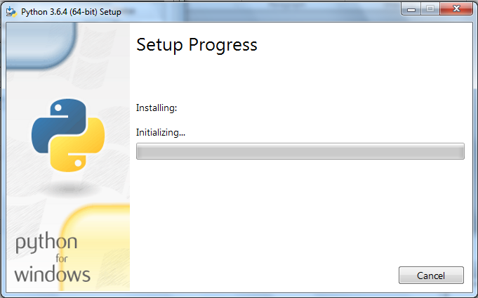
Installing Python3
Initializing

Slide 11
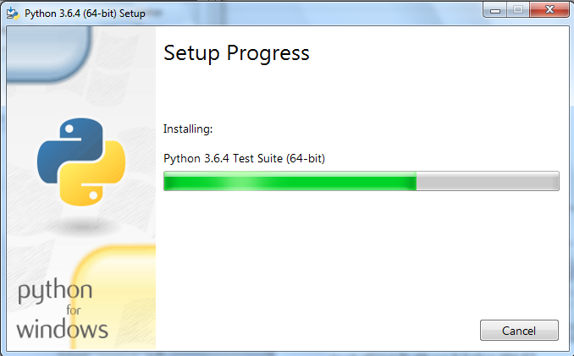
Installing Python3
Install in progress…

Slide 12
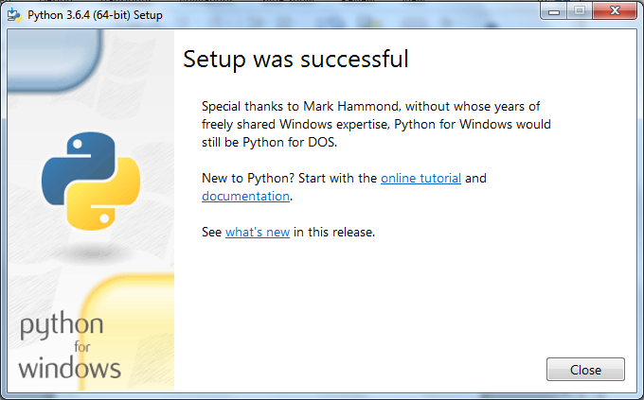
Installing Python3
Click: Close

Slide 13
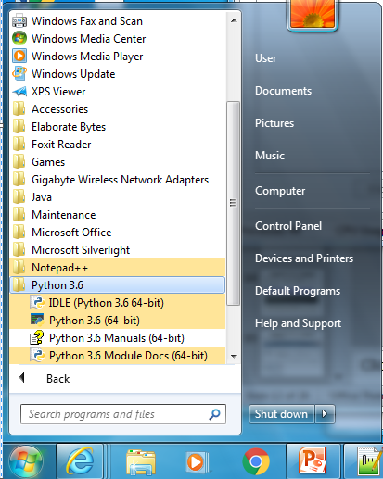
Review of Python3
Click: Start. Python3.6 folder now exists.
Python3.6 folder contains:
IDLE (IDE)
Python 3.6 (Console)
Python3.6 Manuals
Python3.6 Module Docs

Slide 14
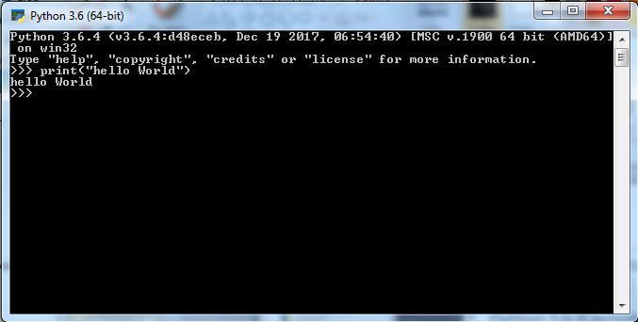
Review of Python3
Click: Python3.6 for Console Window.
Allows interactive entry of code…

Slide 15
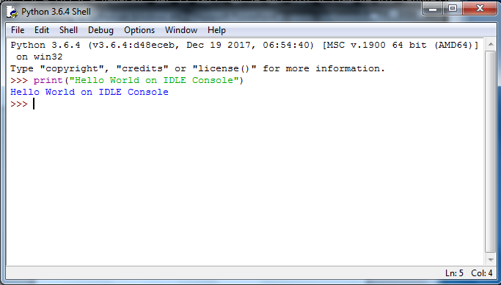
Review of Python3
Click: Python3.6 IDLE.
Launch IDLE Shell window. Allows interactive entry of code…

Slide 16
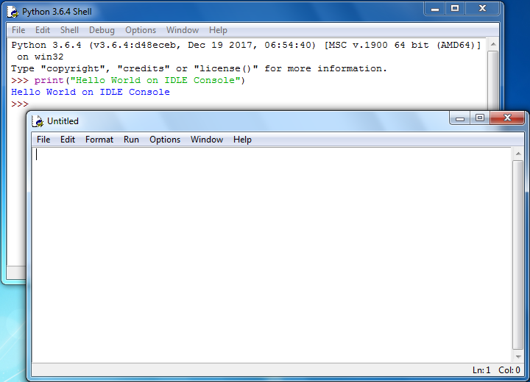
Review of Python3
Click: File - - > New File...
Creates a new window for writing python code.

Slide 17
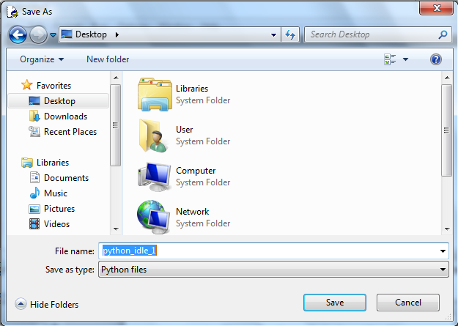
Review of Python3
On new window click: File --> Save As...
Save new window. E.g. python_idle_1.py
Notes:
1

Slide 18
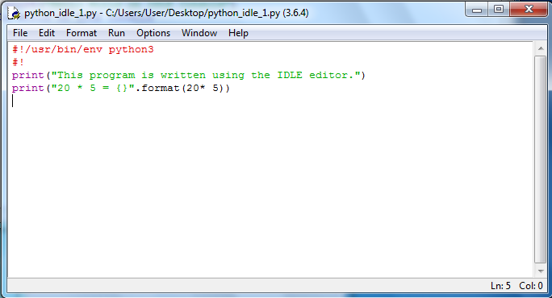
Review of Python3
Write python code in the new window.
Click: File --> Save
Notes:
1

Slide 19
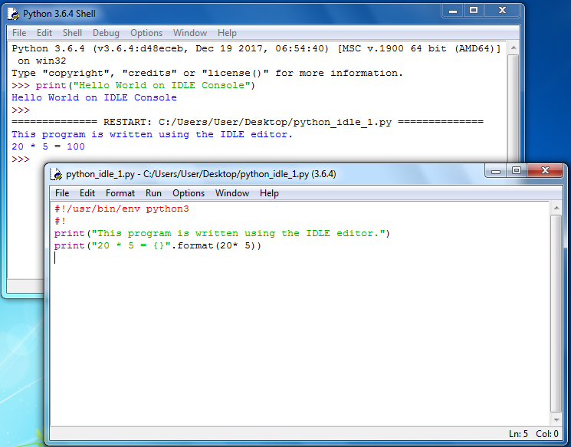
Review of Python3
Click: Run --> Run Module. Output is in Shell
Notes:
1

Slide 20
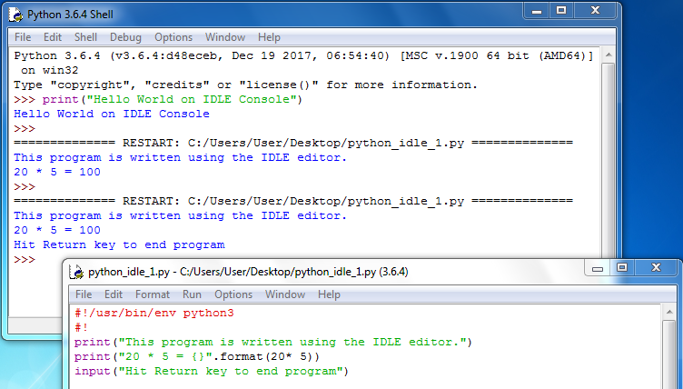
Review of Python3
Edit program and add:
input("Hit return key to end program")
Notes:
1

Slide 21
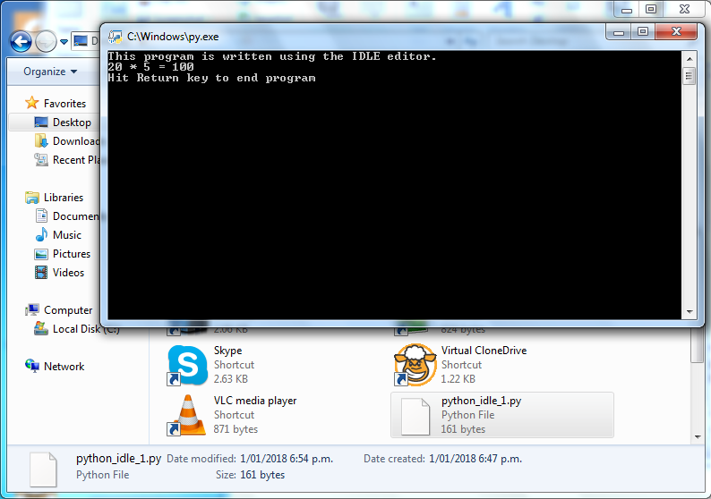
Review of Python3
Use File manager and double-click on file…
Python console window opens. Waits for Return key
Double-click
to launch
Notes:
1

Slide 22
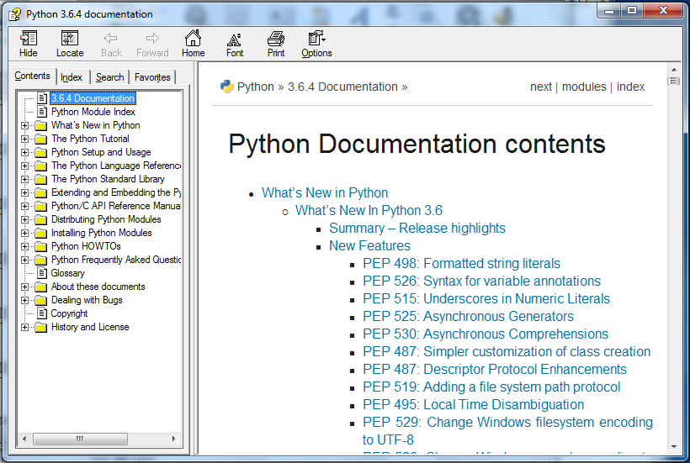
Review of Python3
Click: Start --> Python3.6 Manuals
Notes:
1

Slide 23
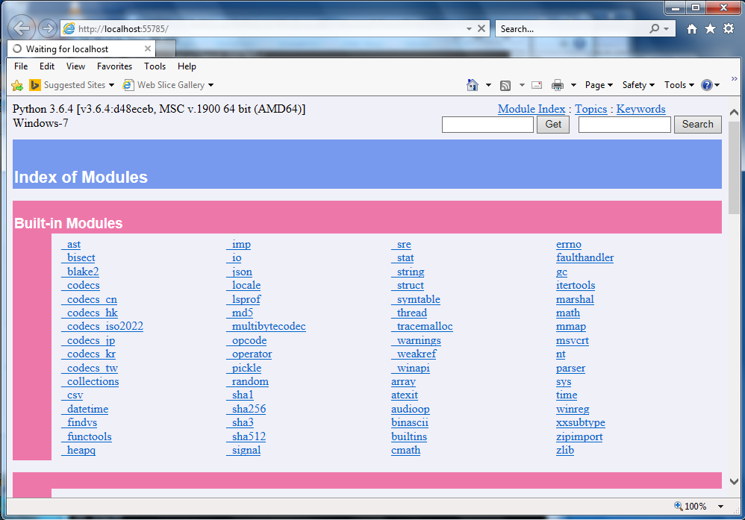
Review of Python3
Click: Start --> Python3.6 Module Docs
Notes:
1

Slide 24
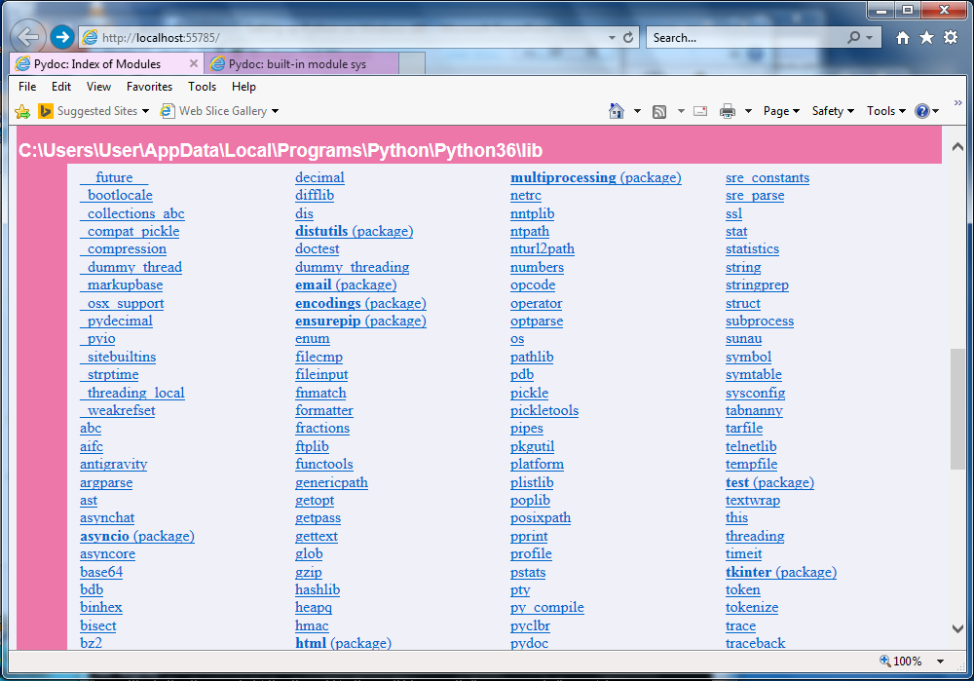
Installing Python3 (plus IDLE)
Information on built-in modules and libraries
Notes:
1

Slide 25
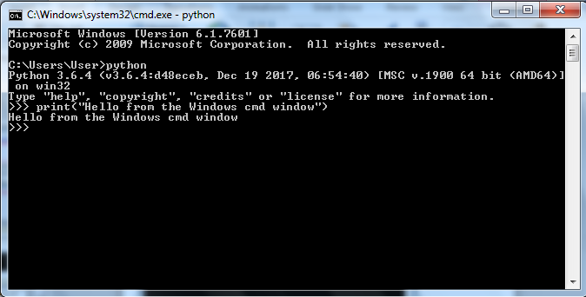
Review of Python3
Windows cmd window.
The path to python is known as during installation we checked:
“Add Python 3.6 to PATH”
Notes:
1

Slide 26
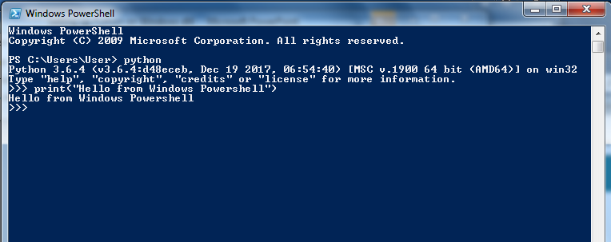
Review of Python3
Windows Powershell window.
The path to python is known as during installation we checked:
“Add Python 3.6 to PATH”
Notes:
1

Slide 27
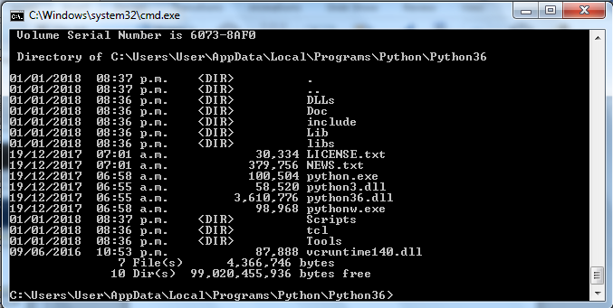
Review of Python3
FYI: Location of Python related files…
Notes:
1

Slide 28
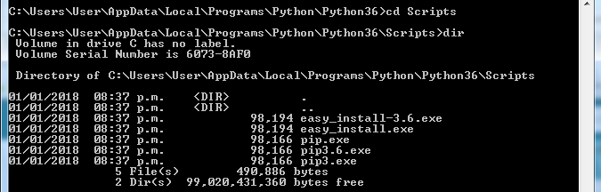
Review of Python3
FYI: cd Scripts for the location of pip3
For copying files from the python package index. PyPI.
Notes:
1

Slide 29
Installing and Review of Python3
End of Python installation and setup
Notes:
1

Slide 30
Notepad Plus Plus (Notepad++)
A source code editor

Slide 31
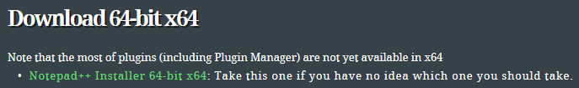
Notepad Plus Plus (Notepad++)
Notepad++ is a free, open-source, code editor.
Home page: https://notepad-plus-plus.org/
Download:
https://notepad-plus-plus.org/download/
Scroll Down and click on Notepad++ Installer 64-bit
Click on Save to download

Slide 32
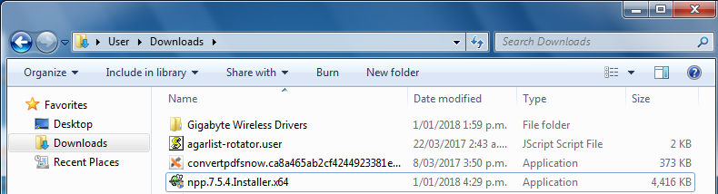
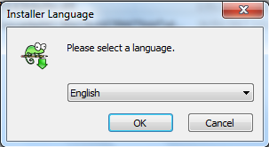
Notepad Plus Plus (Notepad++)
Install Notepad++
Go to Downloads folder and double click on npp file…
Click to approve install, and then select language…

Slide 33
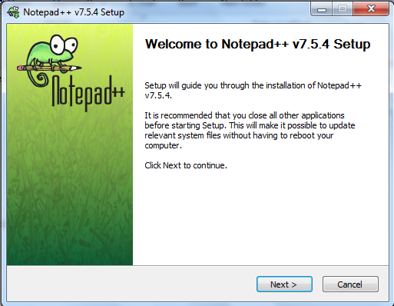
Notepad Plus Plus (Notepad++)
Installation…
Click: Next >…

Slide 34
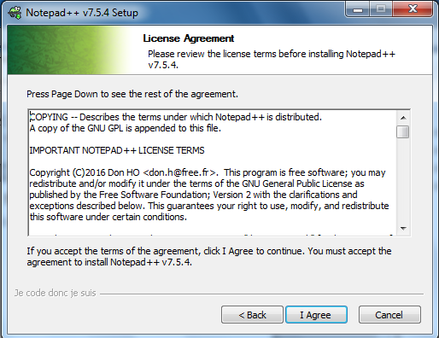
Notepad Plus Plus (Notepad++)
Installation. Accept Licence agreement…
Click: I Agree…

Slide 35
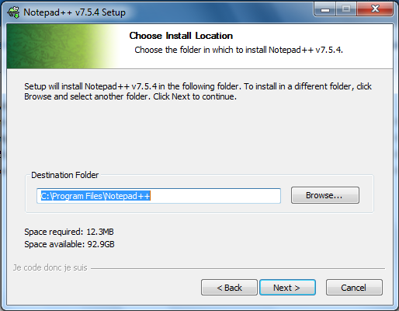
Notepad Plus Plus (Notepad++)
Installation. Choose Install Location…
Click: Next >…

Slide 36
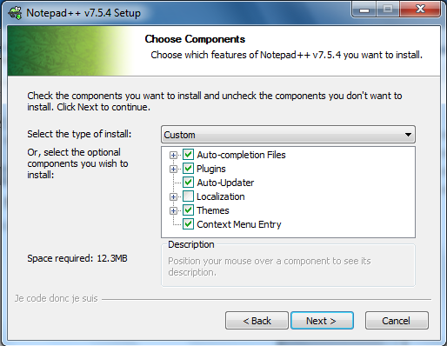
Notepad Plus Plus (Notepad++)
Installation. Choose Components…
Click: Next >…

Slide 37
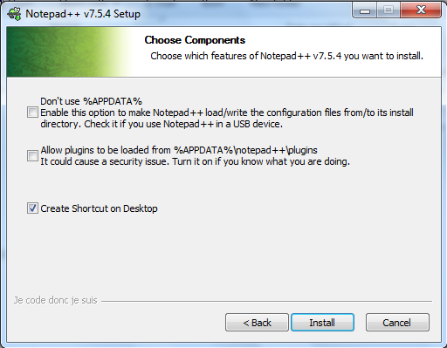
Notepad Plus Plus (Notepad++)
Installation. Choose Components…
Click: Install…

Slide 38
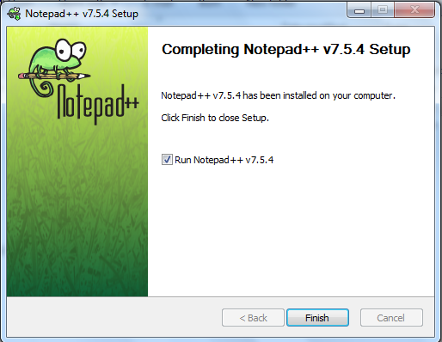
Notepad Plus Plus (Notepad++)
Installation. Choose Components…
Click: Finish…

Slide 39
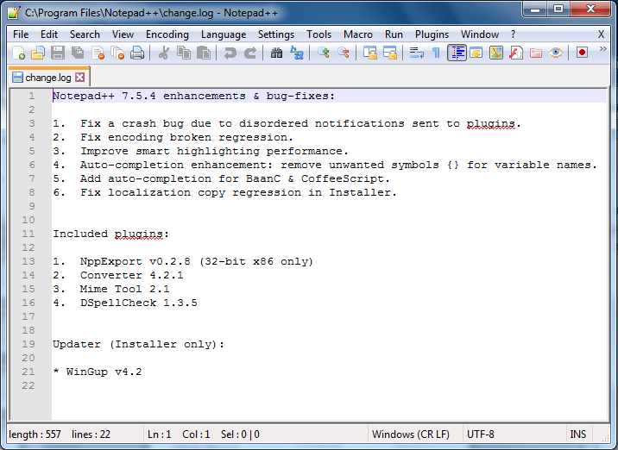
Notepad Plus Plus (Notepad++)
Launched…
On Menu bar click on Settings --> Preferences…

Slide 40
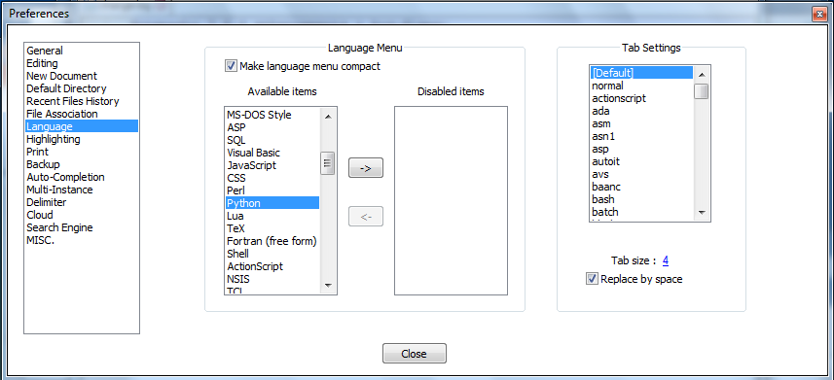
Notepad Plus Plus (Notepad++)
Select Language…
Check: A tab is to be Replaced by 4 x spaces.
Then click: Close

Slide 41
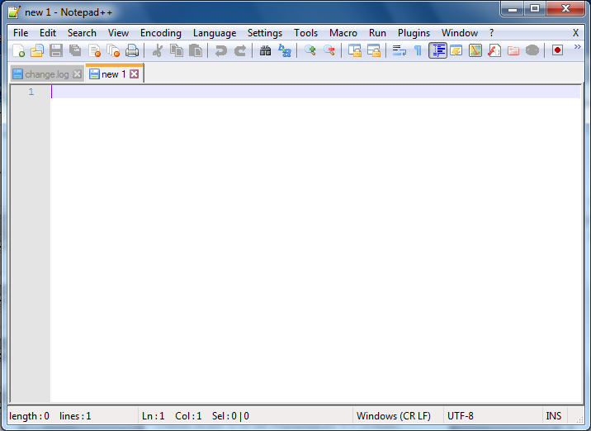
Notepad Plus Plus (Notepad++)
Create new editing session…
Click on the new file icon.

Slide 42
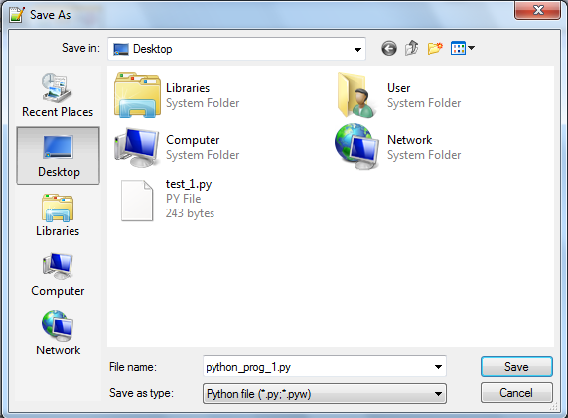
Notepad Plus Plus (Notepad++)
Save new file: File --> Save As…
Click on Place: E.g. Desktop.
Provide python program file name. E.g. python_prog_1
Use drop down menu to select Python File (*py *.pyw)
Click: Save
Notes:
1

Slide 43
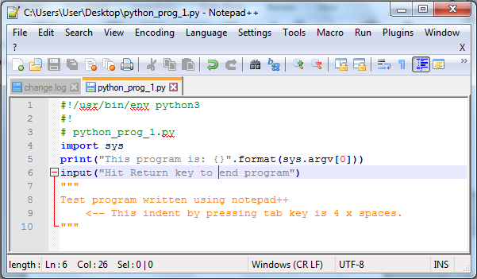
Notepad Plus Plus (Notepad++)
Write a test program and save…
Notes:
1

Slide 44
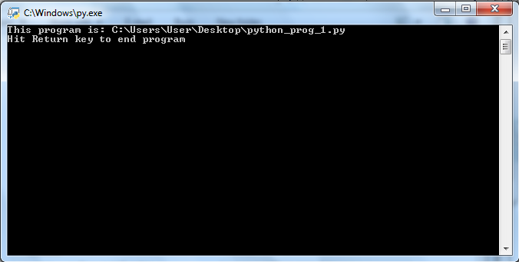
Notepad Plus Plus (Notepad++)
Double click on file to run the program…
Notes:
1

Slide 45
Notepad Plus Plus (Notepad++)
End of Notepad installation and setup.
Additional editing preferences you may like:
Settings --> Preferences --> Auto-Completion
Check the boxes for: (, [, {, “ and ‘.
Notes:
1

Slide 46
Jupyter Notebook
A web-browser interface for writing python code.
Notes:
1

Slide 47
Jupyter Notebook
Formerly IPython Notebook.
Jupyter Notebook provides the web-based client, while IPython remains as the server engine.
Home page: http://jupyter.org/
Use cmd window to check pip is at latest version:
> pip3 install --upgrade pip
Notes:
1

Slide 48
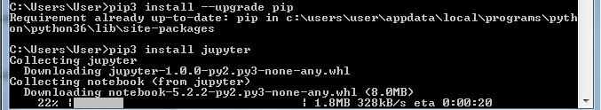
Jupyter Notebook
Install Jupyter (and IPython)
> pip3 install jupyter
Notes:
1

Slide 49
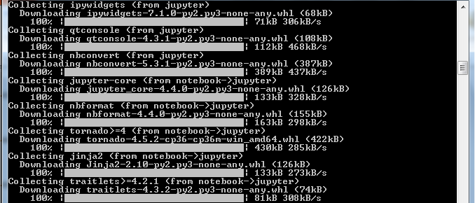
Jupyter Notebook
Install Jupyter (and IPython) continues…
Notes:
1

Slide 50
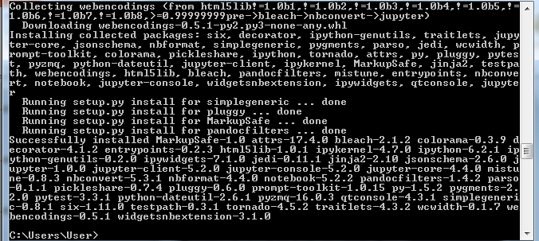
Jupyter Notebook
Install Jupyter (and IPython) completes…
Notes:
1

Slide 51
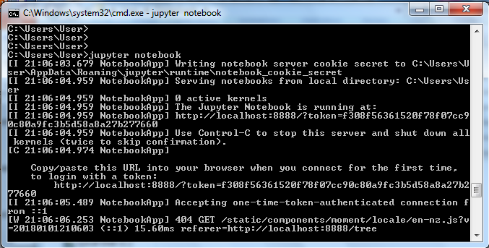
Jupyter Notebook
Launching Jupyter Notebook from cmd window…
> jupyter notebook
Notes:
1

Slide 52
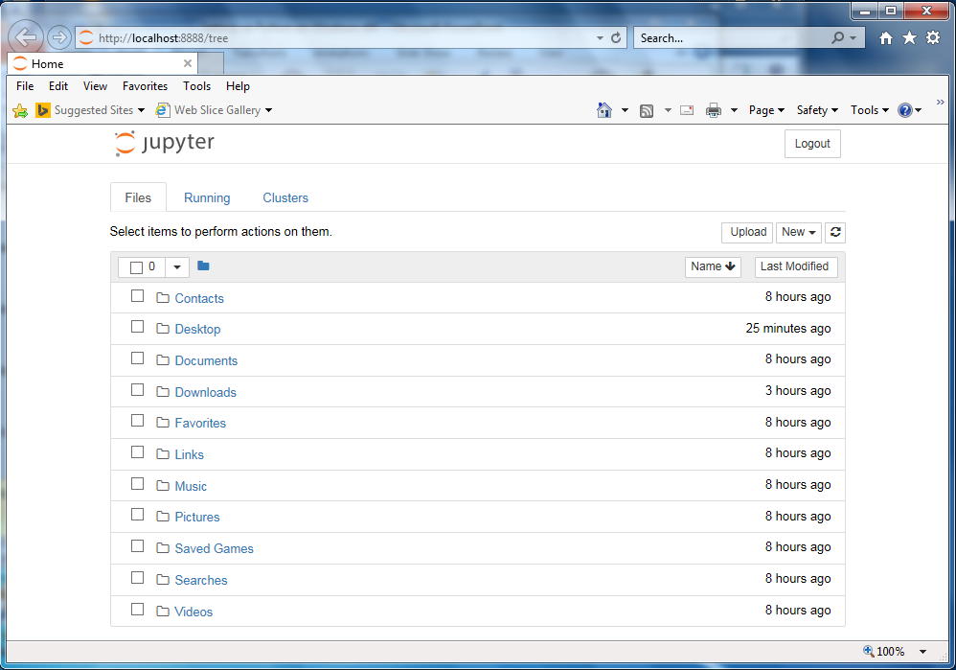
Jupyter Notebook
Jupyter client displays in web-browser
Notes:
1

Slide 53
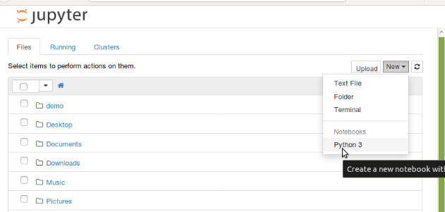
Jupyter Notebook
Click: New and Python3
To create new jupyter notebook
Notes:
1

Slide 54
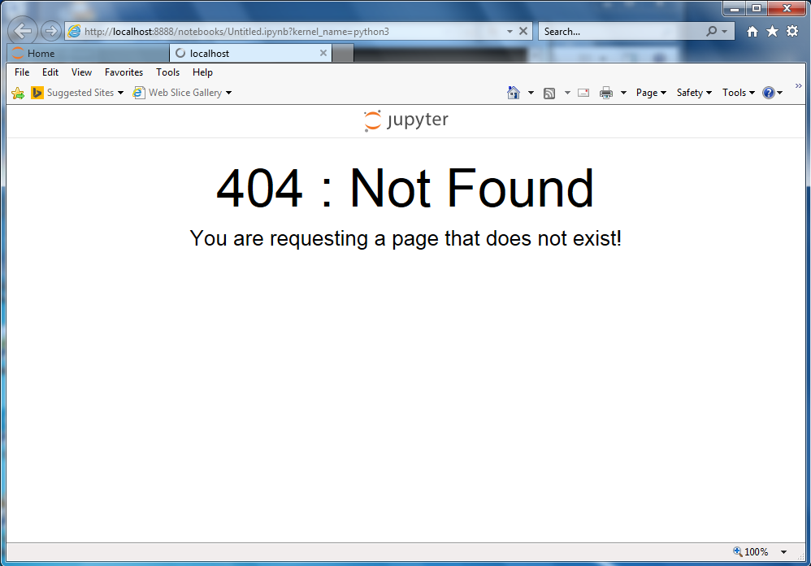
Jupyter Notebook
Glitch. Don’t Panic!…
Click:Home tab then Click: localhost tab…
Notes:
1

Slide 55
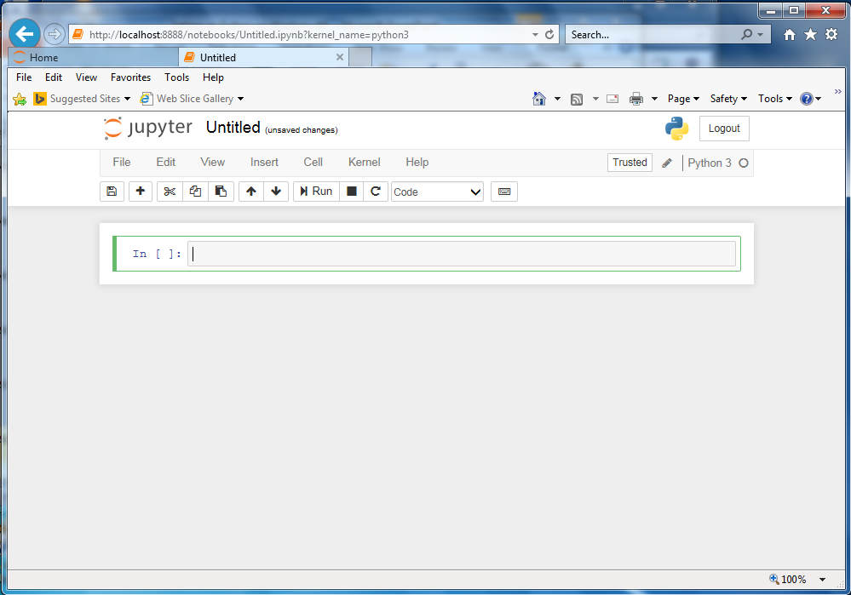
Jupyter Notebook
Jupyter client for the file named Untitled.ipynb…
Notes:
1

Slide 56
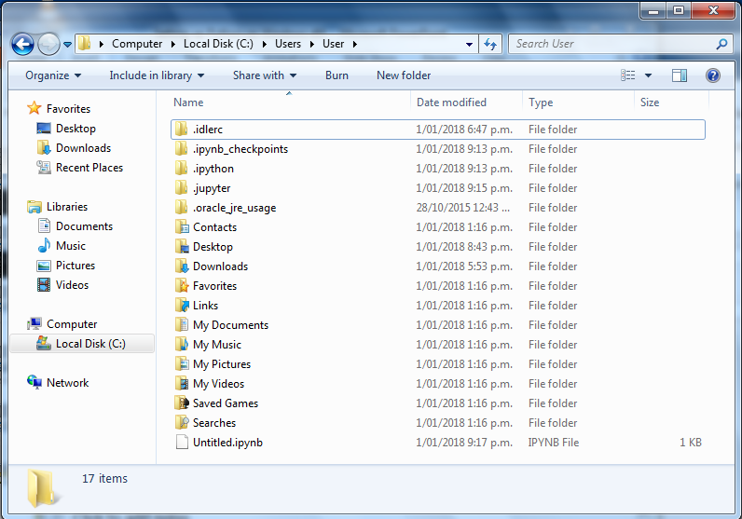
Jupyter Notebook
Untitled.ipynb file now exists…
Notes:
1

Slide 57

Jupyter Notebook
Click File and then click on Rename…
Notes:
1

Slide 58

Jupyter Notebook
Rename the file…
Notes:
1

Slide 59

Jupyter Notebook
Jupyter now with the renamed file…
File manager now shows the file renamed…
Notes:
1

Slide 60


Jupyter Notebook
Write python code in a cell…
Click: Run icon to execute the code…
Notes:
1

Slide 61

Jupyter Notebook
The code executes and output is displayed…
…after execution a new cell is created
Notes:
1

Slide 62
Desktop
Notepad++
Main code
Jupyter
code snippets
Cmd window
Run program
Notes:
1

Slide 63
Jupyter Notebook
End of Jupyter Notebook installation.
Notes:
1

Slide 64
PyInstaller
PyInstaller bundles a Python application and all its dependencies into a single package.
https://pyinstaller.readthedocs.io/en/stable/
Notes:
1

Slide 65

PyInstaller
Use pip to search for PyInstaller…
Notes:
1

Slide 66

PyInstaller
Use pip to install PyInstaller…
Notes:
1

Slide 67

PyInstaller
Verify PyInstaller is installed OK…
Notes:
1

Slide 68


PyInstaller
Write a simple Test program...
Check it runs OK…
Notes:
1

Slide 69

PyInstaller
pyinstaller –onefile python_test_1.py…
…continues...
Notes:
1

Slide 70

PyInstaller
…continuing creating one .exe file for Windows…
Notes:
1

Slide 71

PyInstaller
Double-click to check the file has been created OK…
Notes:
1

Slide 72

PyInstaller
Command window opens and program runs…
Do the PIP install…
Notes:
1

Slide 73

PyInstaller
Copy program to “Test” account…
i.e. Distribution of executable.
Notes:
1

Slide 74
PyInstaller
Log out of “User” account.
Log into: “Test” account.
Notes:
1

Slide 75

PyInstaller
“Test” account does not recognise Python /
consider Python to be installed…

Slide 76

PyInstaller
From “Test” account, run python_test_1.exe
~ 6MB file

Slide 77


PyInstaller
Program may also be run by double-clicking on file…

Slide 78
PyInstaller
End of PyInstaller presentation.
Notes:
1

Slide 79
Learning Python using Jupyter Notebook
In 2017 Lawrence D’Oliveiro delivered two “Introduction to Python” presentations to the Hamilton Python Users Group . He delivered the presentation using Jupyter Notebook. His ipynb files may be obtained from:
https://github.com/HamPUG/meetings/tree/master/2017/2017-03-13/ldo
and
https://github.com/HamPUG/meetings/tree/master/2017/2017-04-10/ldo
Plus the 12 March 2018 presentation:
https://github.com/HamPUG/meetings/tree/master/2018/2018-03-12
Notes:
1

Slide 80
End of Presentation
Questions
Notes:
1

Slide 81
Addendum for PyInstaller
Notes:
1

Slide 82

PyInstaller – Code that doesn’t work
Program: python_test_2.py…
Notes:
1

Slide 83

PyInstaller – Code that doesn’t work
Program Runs OK: python python_test_2.py
Notes:
1

Slide 84

PyInstaller – Code that doesn’t work
PyInstaller converts program converts to .exe OK…
Notes:
1

Slide 85

PyInstaller – Code that doesn’t work
Run the .exe: python_test_2.exe
Unable to read: python_test_2.exe
Notes:
1

Slide 86
__end__
Notes:
<number>

